Slide 1
Algorithm Selection
How to pick ML Algorithms

Slide 2
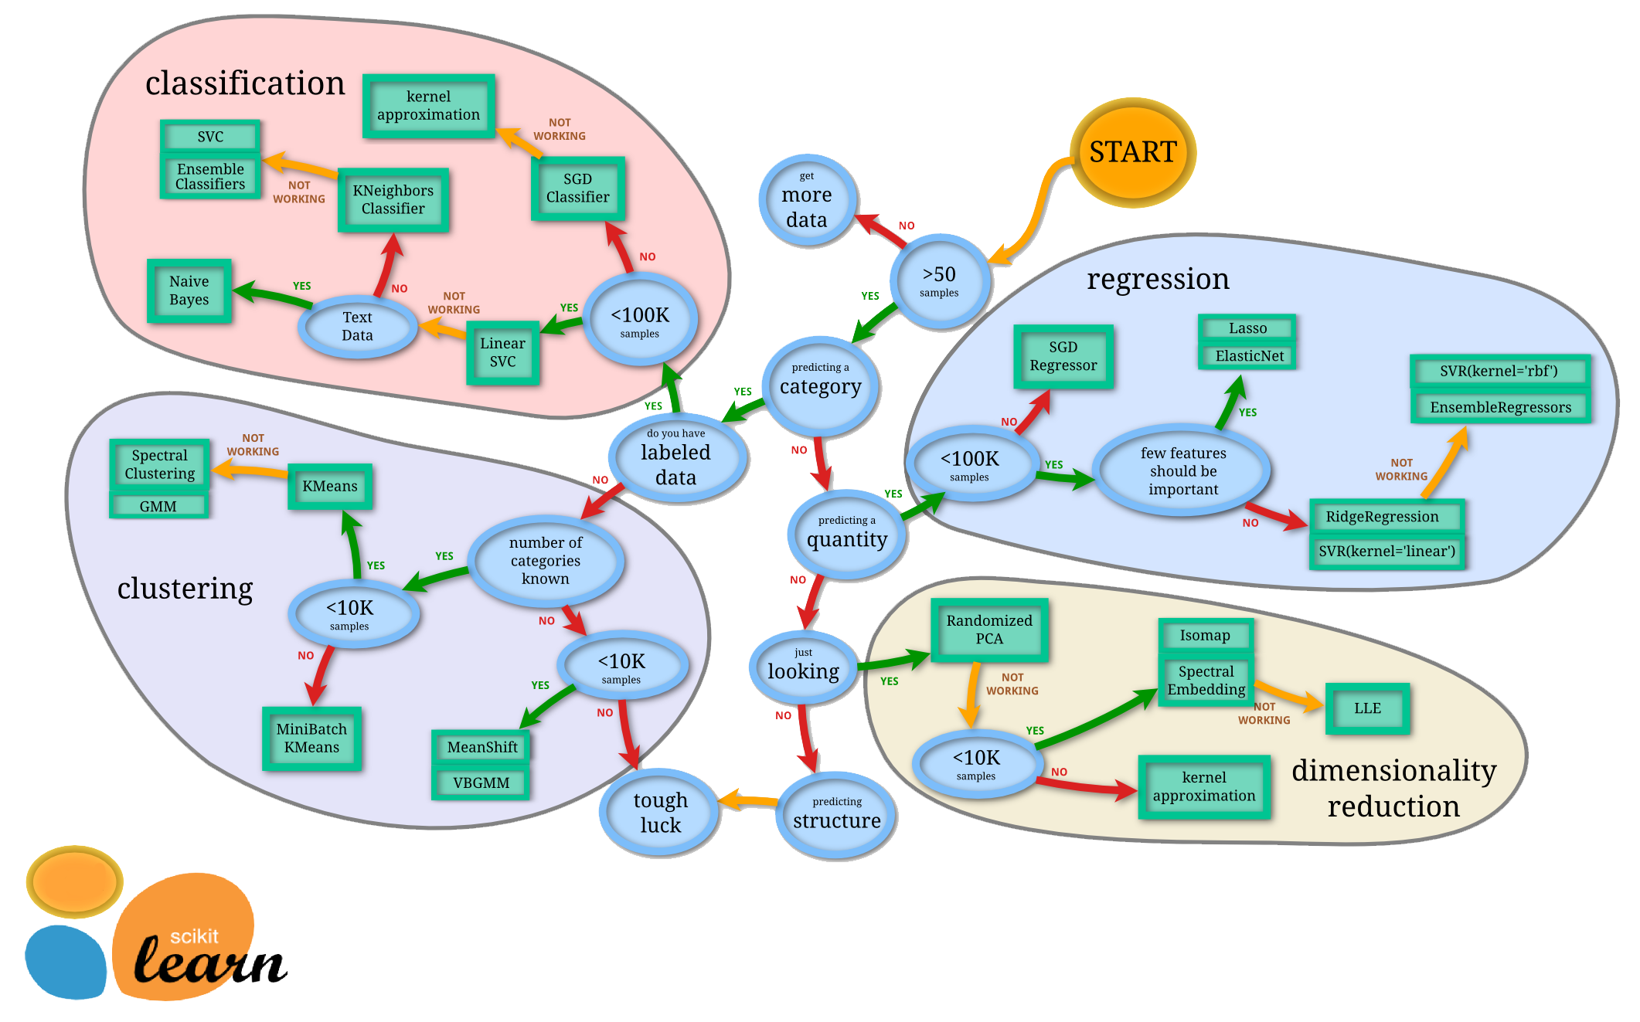

Slide 3
Anatomy of ML Algorithms
We will discuss how machine learning algorithms operate in general.
Goal is to explain a few essential concepts on the flow and basic building blocks.

Slide 4
The Basic Flow ML Algorithms
Predict or Inference
hypothesis function hθ​(x) = θ0 + θ1​x1​ + θ2​x2​ + θ3​x3​ +⋯+ θn​xn​
Error or Loss
Cost function MSE
Train or Learn
Gradient Descent function
Notes:
hθ​(x)=θ0​+θ1​x1​+θ2​x2​+θ3​x3​+⋯+θn​xn​
In order to develop intuition about this function, we can think about \theta_0θ0​ as the basic price of a house, \theta_1θ1​ as the price per square meter, \theta_2θ2​ as the price per floor, etc. x_1x1​ will be the number of square meters in the house, x_2x2​ the number of floors, etc.
Types of math used:
Linear algebra to do mainly matrix math, Statistics
Statistics provide many ways to measure Error, Loss or Cost
Calculus used with Gradient Descent
Provide example of how you go through a model,
Guess the answer
See how well you guest
Adjust the Theta

Slide 5
Building Blocks of Many ML Algorithms
Linear Regression
Logistic Regression

Slide 6
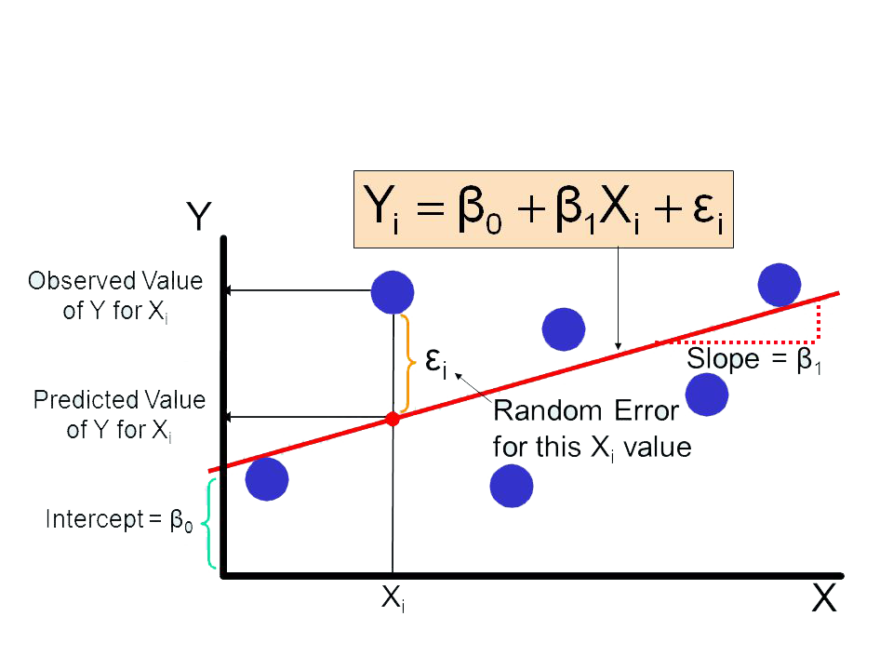
Linear Regression
Notes:
It is one of the most widely known modeling technique. Linear regression is usually among the first few topics which people pick while learning predictive modeling. In this technique, the dependent variable is continuous, independent variable(s) can be continuous or discrete, and nature of regression line is linear.
Linear Regression establishes a relationship between dependent variable (Y) and one or more independent variables (X) using a best fit straight line (also known as regression line).
It is represented by an equation Y=a+b*X + e, where a is intercept, b is slope of the line and e is error term. This equation can be used to predict the value of target variable based on given predictor variable(s).
The difference between simple linear regression and multiple linear regression is that, multiple linear regression has (>1) independent variables, whereas simple linear regression has only 1 independent variable. Now, the question is “How do we obtain best fit line?”.
How to obtain best fit line (Value of a and b)?
This task can be easily accomplished by Least Square Method. It is the most common method used for fitting a regression line. It calculates the best-fit line for the observed data by minimizing the sum of the squares of the vertical deviations from each data point to the line. Because the deviations are first squared, when added, there is no cancelling out between positive and negative values.
We can evaluate the model performance using the metric R-square. To know more details about these metrics, you can read: Model Performance metrics Part 1, Part 2 .
Important Points:
There must be linear relationship between independent and dependent variables
Multiple regression suffers from multicollinearity, autocorrelation, heteroskedasticity.
Linear Regression is very sensitive to Outliers. It can terribly affect the regression line and eventually the forecasted values.
Multicollinearity can increase the variance of the coefficient estimates and make the estimates very sensitive to minor changes in the model. The result is that the coefficient estimates are unstable
In case of multiple independent variables, we can go with forward selection, backward elimination and step wise approach for selection of most significant independent variables.

Slide 7
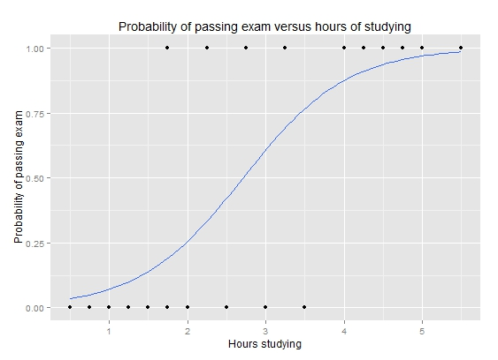
Logistic Regression
Notes:
Logistic regression is used to find the probability of event=Success and event=Failure. We should use logistic regression when the dependent variable is binary (0/ 1, True/ False, Yes/ No) in nature. Here the value of Y ranges from 0 to 1 and it can represented by following equation.
odds= p/ (1-p) = probability of event occurrence / probability of not event occurrence ln(odds) = ln(p/(1-p)) logit(p) = ln(p/(1-p)) = b0+b1X1+b2X2+b3X3....+bkXk
Above, p is the probability of presence of the characteristic of interest. A question that you should ask here is “why have we used log in the equation?”.
Since we are working here with a binomial distribution (dependent variable), we need to choose a link function which is best suited for this distribution. And, it is logit function. In the equation above, the parameters are chosen to maximize the likelihood of observing the sample v
Important Points:
It is widely used for classification problems
Logistic regression doesn’t require linear relationship between dependent and independent variables. It can handle various types of relationships because it applies a non-linear log transformation to the predicted odds ratio
To avoid overfitting and underfitting, we should include all significant variables. A good approach to ensure this practice is to use a step wise method to estimate the logistic regression
It requires large sample sizes because maximum likelihood estimates are less powerful at low sample sizes than ordinary least square
The independent variables should not be correlated with each other i.e. no multi collinearity. However, we have the options to include interaction effects of categorical variables in the analysis and in the model.
If the values of dependent variable is ordinal, then it is called as Ordinal logistic regression
If dependent variable is multi class then it is known as Multinomial Logistic regression.

Slide 8
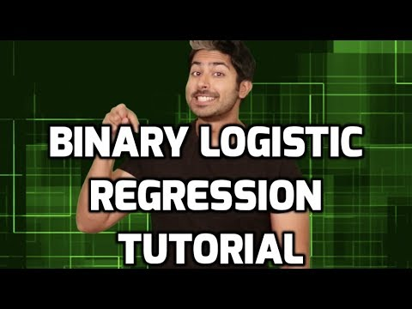
Logistic Regression

Slide 9
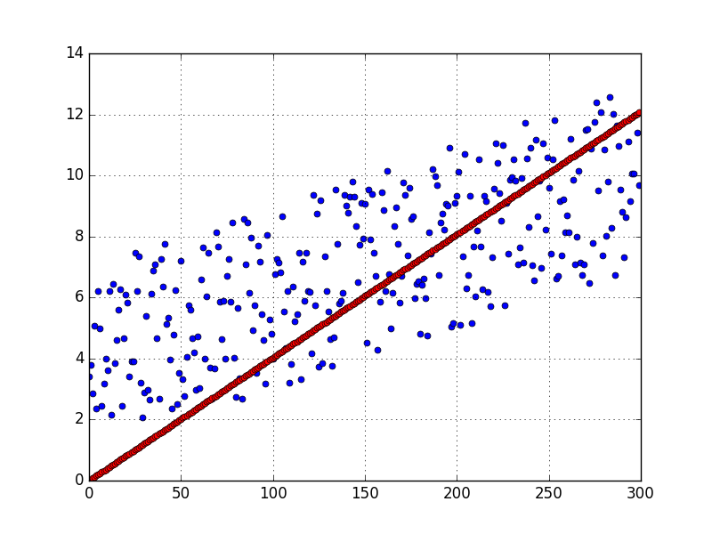
Why Linear Regression is Flawed
Simple linear regression models fit a "straight line". In practice, they rarely perform well.
Their main advantage is that they are easy to interpret and understand.

Slide 10
Why Linear Regression is Flawed
In this regard, simple linear regression suffers from two major flaws:
It's prone to overfit with many input features.
It cannot easily express non-linear relationships.
Let's take a look at how we can address the first flaw.

Slide 11
Regularization in Machine Learning
Extreme example of overfitting:
Let's say you have 100 observations with 100 features in your training dataset.
If you fit a linear regression model with all of those 100 features, you can perfectly "memorize" the training set.
Each coefficient would simply memorize one observation. This model would have perfect accuracy on the training data, but perform poorly on unseen data.
It hasn’t learned the true underlying patterns; it has only memorized the noise in the training data.

Slide 12
Regularization in Machine Learning
Regularization is a technique used to prevent overfitting by artificially penalizing model coefficients.
It can discourage large coefficients (by dampening them).
It can also remove features entirely (by setting their coefficients to 0).
The "strength" of the penalty is tunable.

Slide 13
Regularized Regression Algos
There are 3 common types of regularized linear regression algorithms
Lasso Regression
Ridge Regression
Elastic-Net
Notes:
Lasso Regression (also known as L1 Regularization)
Ridge Regression (also known as L2 Regularization)
Elastic-Net (combination of L1 and L2 Regularization)

Slide 14
Lasso Regression
Lasso, or LASSO, stands for:
Least
Absolute
Shrinkage
Selection Operator
Notes:
L1 Regularization aka Lasso Regularization
This add regularization terms in the model which are function of absolute value of the coefficients of parameters.
The coefficient of the parameters can be driven to zero as well during the regularization process.
Hence this technique can be used for feature selection and generating more parsimonious model

Slide 15
Lasso Regression
Lasso regression penalizes the absolute size of coefficients.
Practically, this leads to coefficients that can be exactly 0.
Thus, Lasso offers automatic feature selection because it can completely remove some features.
Remember, the "strength" of the penalty should be tuned.
A stronger penalty leads to more coefficients pushed to zero.

Slide 16
Ridge Regression
Ridge regression penalizes the squared size of coefficients.
Practically, this leads to smaller coefficients, but it doesn't force them to 0.
In other words, Ridge offers feature shrinkage.
Again, the "strength" of the penalty should be tuned.
A stronger penalty leads to coefficients pushed closer to zero.
Notes:
L2 Regularization aka Ridge Regularization
This add regularization terms in the model which are function of square of coefficients of parameters.
Coefficient of parameters can approach to zero but never become zero

Slide 17
Elastic-Net
Elastic-Net is a compromise between Lasso and Ridge.
Elastic-Net penalizes a mix of both absolute and squared size.
The ratio of the two penalty types should be tuned.
The overall strength should also be tuned.
Notes:
Combination of the above two such as Elastic Nets
This add regularization terms in the model which are combination of both L1 and L2 regularization

Slide 18
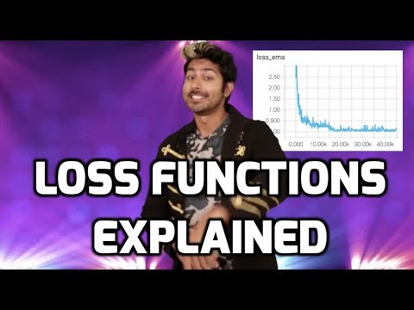
Loss Functions

Slide 19
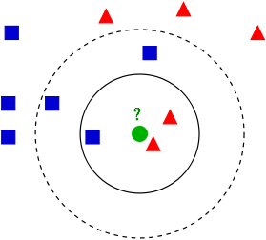
KNN - K Nearest Neighbors
KNN is an ML algorithm that classifies new data points, by a measure of distance, to its K nearest neighbors — in the existing data.
Class A
Class B
—-- K = 3
- - - K = 5
New Data Point
Notes:
KNN can be used for classification — the output is a class membership (predicts a class — a discrete value).
An object is classified by a majority vote of its neighbors, with the object being assigned to the class most common among its k nearest neighbors.
It can also be used for regression — output is the value for the object (predicts continuous values). This value is the average (or median) of the values of its k nearest neighbors.

Slide 20
KNN Considerations
Choosing K: A problem all of its own, best to try different sizes and compare results.
Rule of Thumb: k < sqrt(n) , n = total # of samples
Weights: Necessary to attach “weights” to more important features, could be an iterative process.

Slide 21
KNN Strengths
Simple and intuitive
Can be applied to any type of distribution
Great classifier if Sample size is large.

Slide 22
KNN Weaknesses
Requires a large sample size
Slow to classify.
Need to calculate and compare distance from new example to all other examples in the sample space.
Then, compare example to the k nearest points
Choosing size of K can be tricky
Notes:
The larger you make k, the more smoothing takes place, and eventually you will smooth so much that you will get a model that under-fits the data rather than over-fitting it

Slide 23
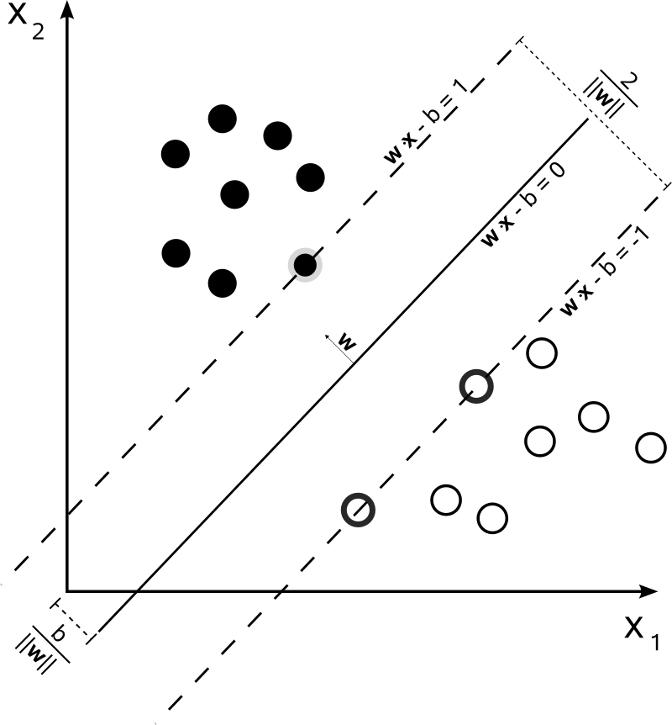
Support Vector Machines
ML algorithm that maps a training set onto a feature space and divides points into classes with a “hyperplane” w.
Support vectors maximize the margin around the hyperplane
Require EXTENSIVE tuning of a “kernel” function.
SVMs classify new points based on what side of the dividing hyperplane they land on.
Notes:
Hyperplane because it can exist in a 3 Dimensional Feature space as a plane,
In 2d Space, hyperplane is just a line.
Support Vectors: Try to find the ideal position for the separating hyperplane. Require EXTENSIVE tuning.

Slide 24
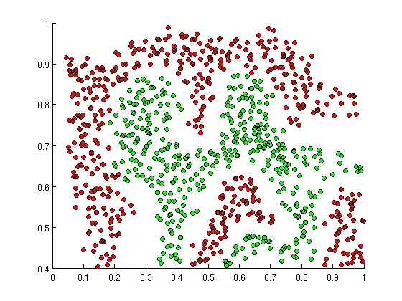
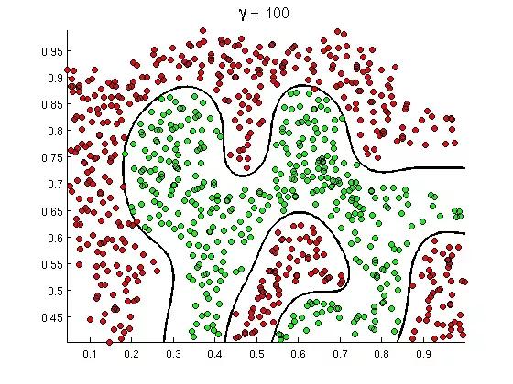
SVMs in Action
SVM

Slide 25
SVM Strengths
Among the most accurate models in Machine Learning.
Can handle non-linear relationships,
Tune kernel parameter to prevent overfitting.
Can deal very effectively with high-dimensional data with something called the “kernel” trick.
Notes:
A shame since its so “expensive” to run.

Slide 26
SVM weaknesses
Both Training and Testing are SLOW
Don’t perform as well with Multi-class data.
Ex: Iris dataset
Kernel function requires extensive tuning.
Requires a lot of memory and processing power.

Slide 27
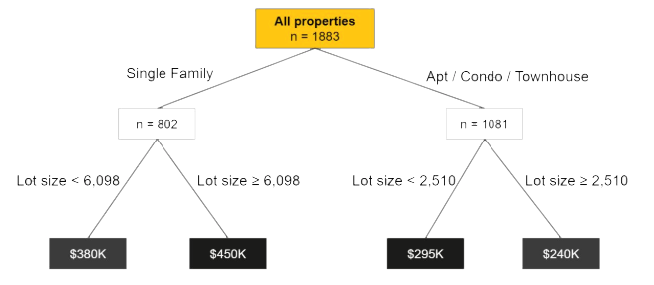
Decision Tree Algorithms
Decision trees model data as a "tree" of hierarchical branches. They make branches until they reach "leaves" that represent predictions.

Slide 28
Decision Tree Algorithms
Unfortunately, decision trees suffer from a major flaw as well. If you allow them to grow limitlessly, they can completely "memorize" the training data, just from creating more and more and more branches.

Slide 29
Tree Ensembles
Ensembles are machine learning methods for combining predictions from multiple separate models.
They allow us to take advantage of the flexibility of decision trees while preventing them from overfitting the training data.
Two most common methods for ensembling are Bagging and Boosting.
Notes:
combines several decision trees to produce better predictive performance than utilizing a single decision tree.
The main principle behind the ensemble model is that a group of weak learners come together to form a strong learner.

Slide 30
Tree Ensembles - Bagging
Bagging attempts to reduce the chance of overfitting.
It trains a large number of "strong" learners in parallel.
A strong learner is a model that's relatively unconstrained.
Bagging then combines all the strong learners together in order to "smooth out" their predictions.
Notes:
Bagging, short for bootstrap aggregating, is a general technique for combining the predictions of many models.
While it can be used to aggregate the outputs of any type of regression or classification model, bagging is usually applied to decision trees.

Slide 31
Tree Ensembles - Boosting
Boosting attempts to improve the predictive flexibility of simple models.
It trains a large number of "weak" learners in sequence.
A weak learner is a constrained model (i.e. you could limit the max depth of each decision tree).
Each one in the sequence focuses on learning from the mistakes of the one before it.
Boosting then combines all the weak learners into a single strong learner.
Notes:
Boosting is another ensemble technique to create a collection of predictors.
In this technique, learners are learned sequentially with early learners fitting simple models to the data and then analyzing data for errors.
In other words, we fit consecutive trees (random sample) and at every step, the goal is to solve for net error from the prior tree.

Slide 32
Tree Ensembles
Ensembling is a general term, but when the base models are decision trees, they have special names: random forests and boosted trees!

Slide 33
Decision Tree Algorithms
Random Forests
Random forests train a large number of "strong" decision trees and combine their predictions through bagging.
There are two sources of "randomness" for random forests:
Each tree is only allowed to choose from a random subset of features to split on (leading to feature selection).
Each tree is only trained on a random subset of observations (a process called resampling).

Slide 34
Decision Tree Algorithms
Random Forests
In practice, random forests tend to perform very well right out of the box.
They often beat many other models that take up to weeks to develop.
They are the perfect "swiss-army-knife"algorithm that almost always gets good results.
They don’t have many complicated parameters to tune.

Slide 35
Decision Tree Algorithms
Boosted Trees
Boosted trees train a sequence of "weak", constrained decision trees and combine their predictions through boosting.
Each tree is allowed a maximum depth, which should be tuned.
Each tree in the sequence tries to correct the prediction errors of the one before it.

Slide 36
Decision Tree Algorithms
Boosted Trees
In practice, boosted trees tend to have the highest performance ceilings.
They often beat many other types of models after proper tuning.
They are more complicated to tune than random forests.

Slide 37
Artificial Neural Networks
Artificial neural networks are computational models which work similar to the functioning of a human nervous system.
There are several kinds of artificial neural networks.
These type of networks are implemented based on the mathematical operations and a set of parameters required to determine the output.

Slide 38
Architecture of an Artificial Neural Network
ANN is a set of connected neurons organized in layers:
input layer: brings the initial data into the system for further processing by subsequent layers of artificial neurons.
hidden layer: a layer in between input layers and output layers, where artificial neurons take in a set of weighted inputs and produce an output through an activation function.
output layer: the last layer of neurons that produces given outputs for the program.

Slide 39
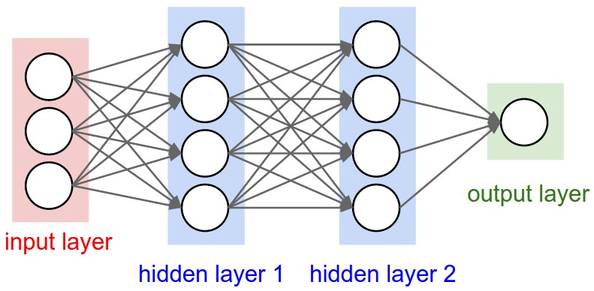
Multi-Layer Neural Network

Slide 40
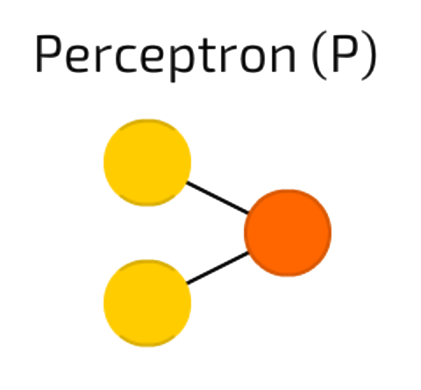
Perceptron
Notes:
Perceptron.
The simplest and oldest model of Neuron, as we know it.
Takes some inputs, sums them up, applies activation function and passes them to output layer.
No magic here.

Slide 41
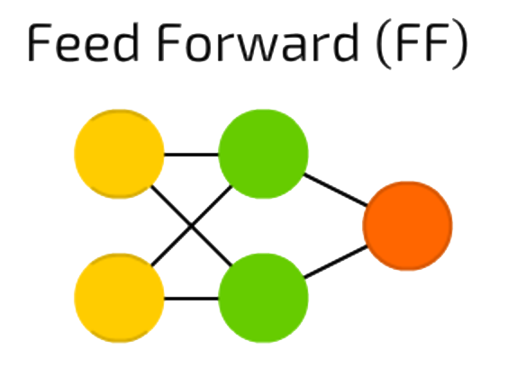
Feed Forward
Notes:
Feed forward neural networks
all nodes are fully connected
activation flows from input layer to output, without back loops
there is one layer between input and output (hidden layer)
In most cases this type of networks is trained using Backpropagation method.

Slide 42
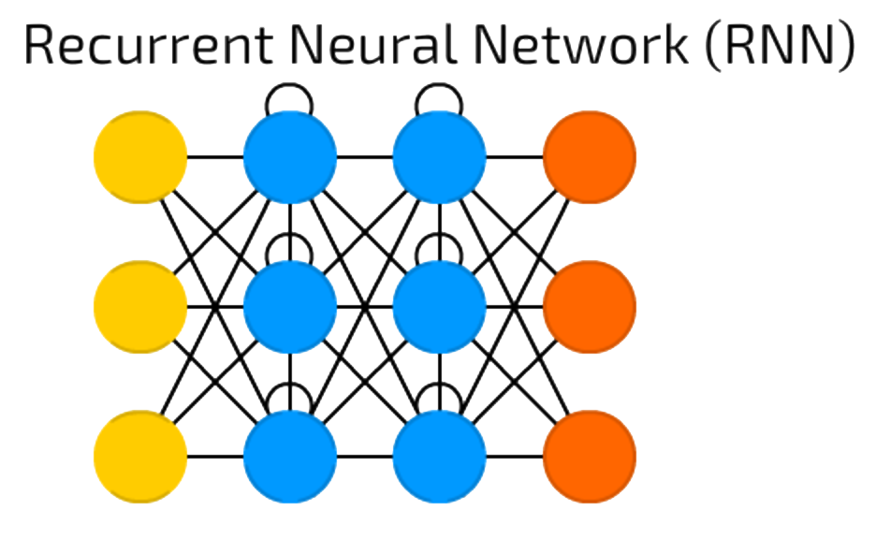
Recurrent Neural Network
Notes:
Recurrent Neural Networks introduce different type of cells — Recurrent cells.
Each of hidden cell received its own output with fixed delay — one or more iterations.
Apart from that, it was like common FNN.
There are many variations — like passing the state to input nodes, variable delays, etc, but the main idea remains the same.
This type of NNs is mainly used when context is important — when decisions from past iterations or samples can influence current ones.
The most common examples of such contexts are texts — a word can be analysed only in context of previous words or sentences.

Slide 43
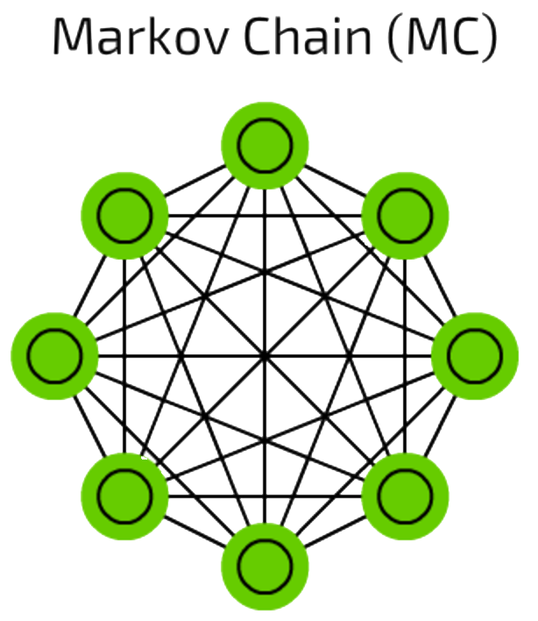
Markov Chain
Notes:
Markov Chains are pretty old concept of graphs where each edge has a probability.
MCs can be used for classification based on probabilities (like Bayesian filters), for clustering (of some sort), and as a finite state machine.

Slide 44
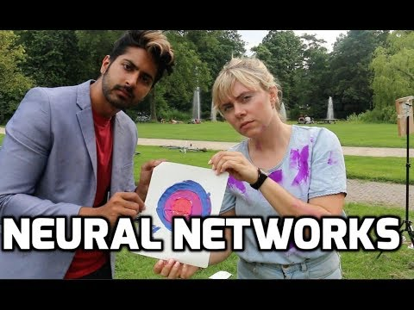
Neural Networks

